Slide 1
Lessons Learned
Alan V. Deardorff
University of Michigan
For presentation to students of Peter Debaere
University of Virginia
April 27, 2020

Slide 2
Lessons Learned from Recent Events
Trump Trade Policies
Brexit
Pandemic
Future of the World Trading System

Slide 3
Trump Trade Policies
Importance of President
US law loopholes
Tariff exemptions
Silence of hurt industries
Tactic of extortion
Public & official unawareness
US as small country
Trade re-routing

Slide 4
Trump Tariffs

Slide 5
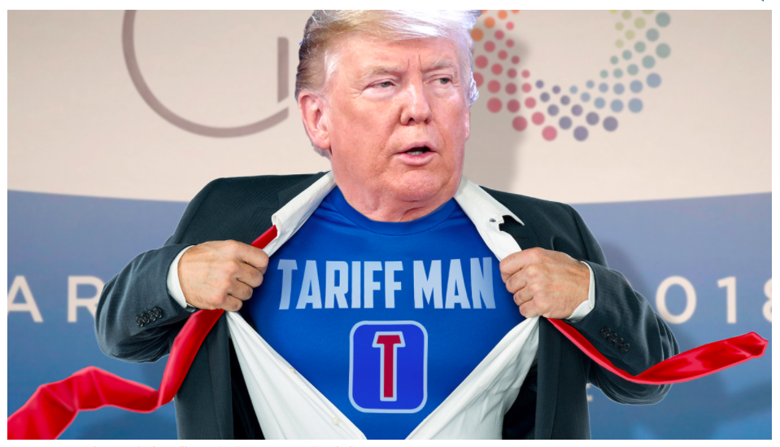
Notes:
MarketWatch
https://www.marketwatch.com/story/trump-says-hes-tariff-man-and-twitter-decides-its-a-superhero-name-2018-12-04

Slide 6
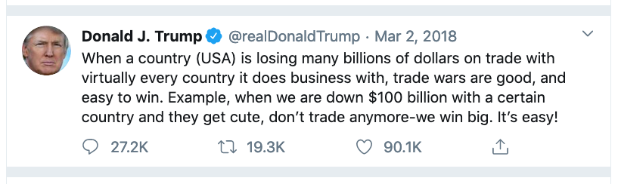

Slide 7
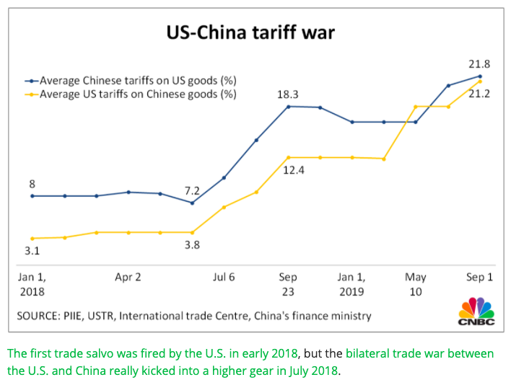
Source: CNBC.com
Notes:
SEPTEMBER 18, 2019 | Yen Nee Lee, CNBC.com
http://nbr.com/2019/09/18/these-4-charts-show-how-us-china-trade-has-changed-during-the-tariff-dispute/

Slide 8
US Trade Laws

Slide 9

Source: traderiskguaranty.com
Notes:
traderiskguaranty.com
https://traderiskguaranty.com/trgpeak/infographic-section-232-tariffs/

Slide 10
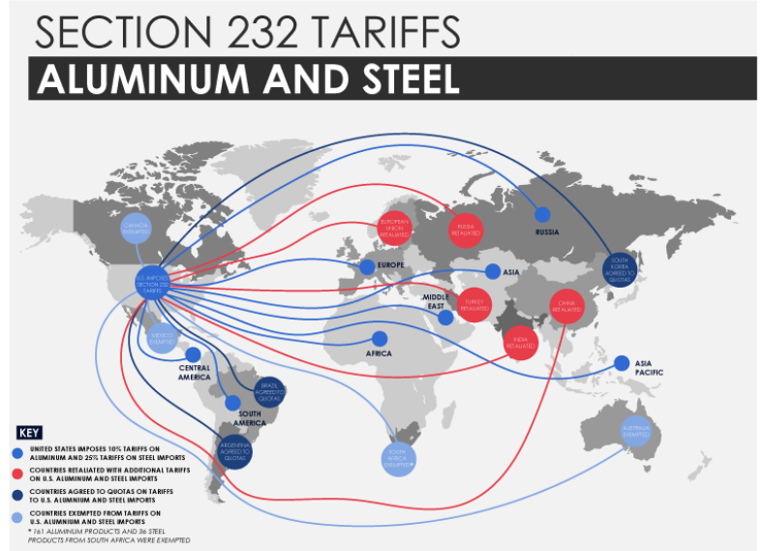
Source: traderiskguaranty.com
Notes:
traderiskguaranty.com
https://traderiskguaranty.com/trgpeak/infographic-section-232-tariffs/

Slide 11
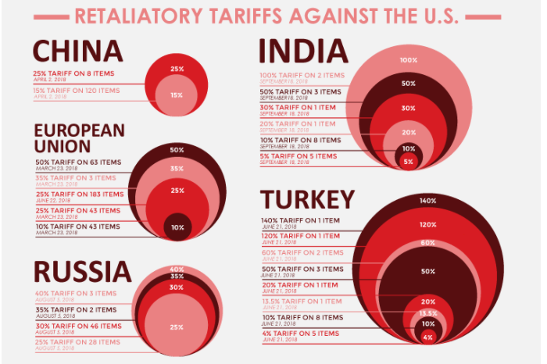
Source: traderiskguaranty.com
Notes:
traderiskguaranty.com
https://traderiskguaranty.com/trgpeak/infographic-section-232-tariffs/

Slide 12
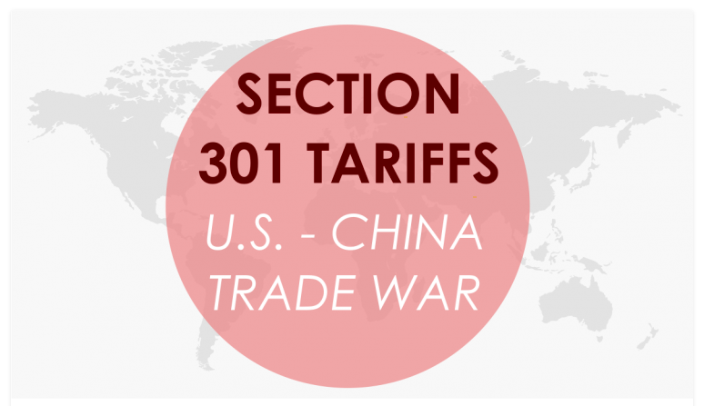
Source: traderiskguaranty.com
Notes:
traderiskguaranty.com
https://traderiskguaranty.com/trgpeak/infographic-section-301-tariffs-us-china/

Slide 13
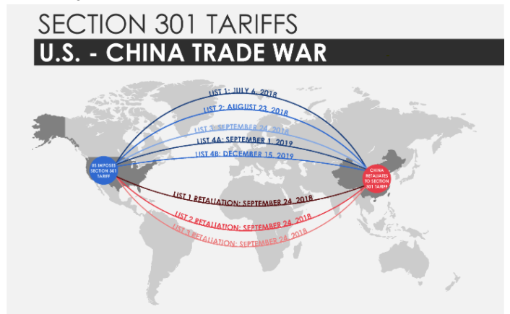
Source: traderiskguaranty.com
Notes:
traderiskguaranty.com
https://traderiskguaranty.com/trgpeak/infographic-section-301-tariffs-us-china/

Slide 14
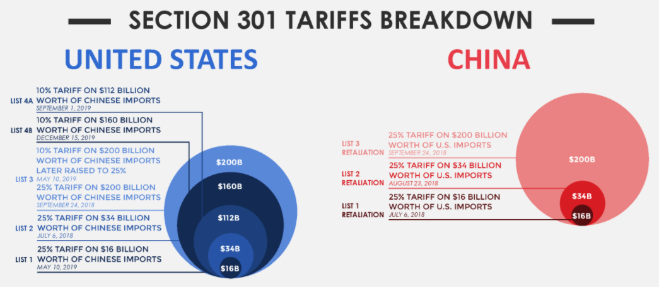
Source: traderiskguaranty.com
Notes:
traderiskguaranty.com
https://traderiskguaranty.com/trgpeak/infographic-section-301-tariffs-us-china/

Slide 15
Tariff Exemptions

Slide 16
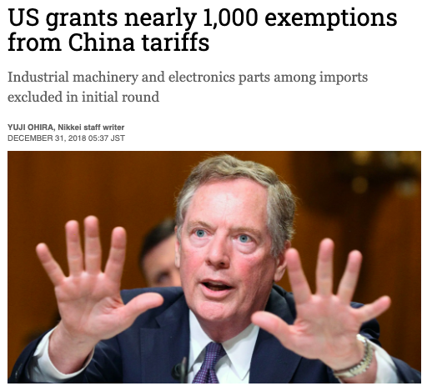
U.S. Trade Representative Robert Lighthizer, whose office recently approved the first tariff exclusions. © Reuters
Source: Nikkei Asian Review
Notes:
Ohira, Yuji, December 31, 2018, Nikkei Asian Review
https://asia.nikkei.com/Economy/Trade-war/US-grants-nearly-1-000-exemptions-from-China-tariffs

Slide 17
Tariff Incidence

Slide 18
Tariff raises price at home and lowers it abroad:

Slide 19
Tariff Incidence, Large Country
Tariff
  raises price at home and
  lowers it abroad:
P
P_{aut}
XS*
P₁
t
d
P*₁
MD
P_{aut}*
M₁=X*₁
M₀=X*₀
M,X*

Slide 20
Tariff Incidence, Large Country
Welfare effects of a large-country tariff, starting from free trade
Home:
  Private loses −(a+b)
  Gov’t gains +(a+c)
  Country: + c − b
Foreign
  Private loses −(c+d)
World loses −(b+d)
Welfare effects
P
P_{aut}
XS*
P₁
a
b
t
c
d
P*₁
MD
P_{aut}*
M₁=X*₁
M₀=X*₀
M,X*

Slide 21
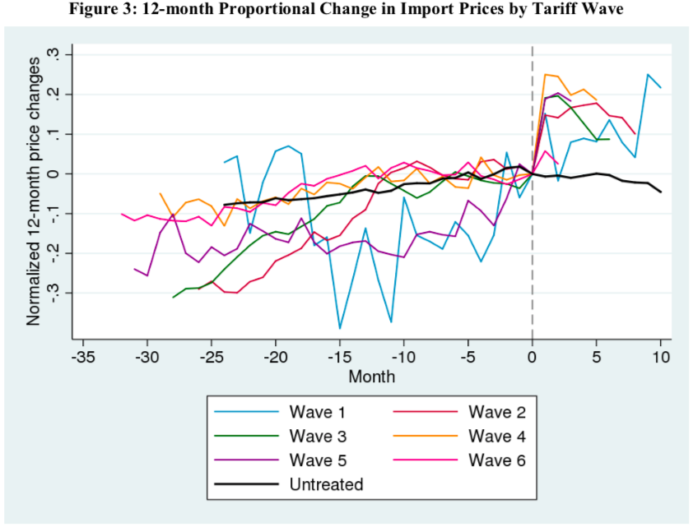
Source: Amiti, et al. 2019.

Slide 22
Tariff Incidence, US
Tariff
  raises price at home almost by full tariff
  lowers it abroad hardly at all:
P
P₁
t
XS*
P*₁
MD
M₁=X*₁
M₀=X*₀
M,X*

Slide 23
Trade Re-Routing

Slide 24
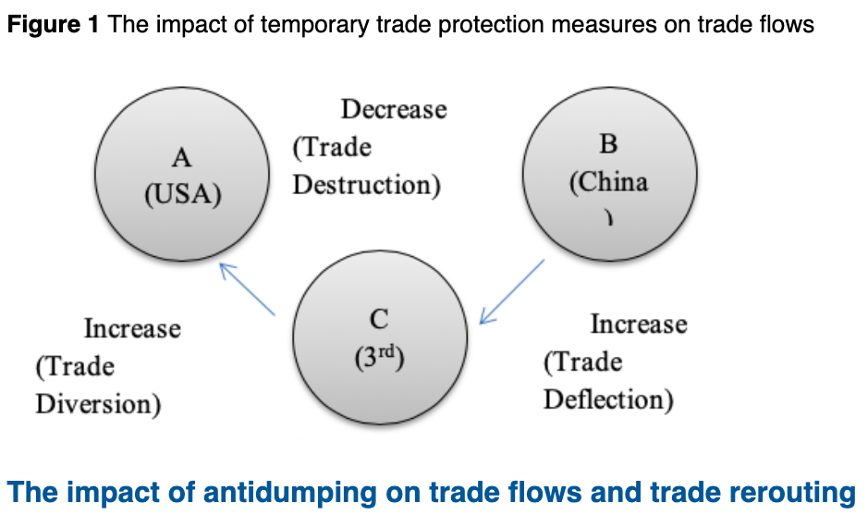
Source: Liu & Shi, 2019
Notes:
Liu, Xuepeng and Huimin Shi, “(Still) made in China: how tariff hikes may trigger re-routing circumvention,” VOX, July 11, 2019i
https://voxeu.org/article/how-tariff-hikes-may-trigger-re-routing-circumvention

Slide 25
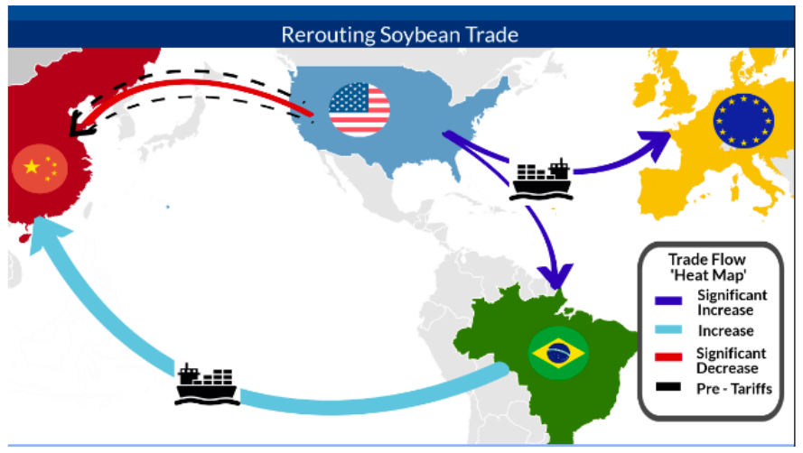
Source: Moehr, 2018
Notes:
Moehr, Ole, “Trade Disrupted: US and China Need More Than A Truce,” Atlantic Council, December 5, 2018.
https://www.atlanticcouncil.org/blogs/econographics/trade-disrupted-us-and-china-need-more-than-a-truce/

Slide 26
Brexit
British public dislike of EU
EU membership so complex
EU country sub-units have power
UK trade deals

Slide 27
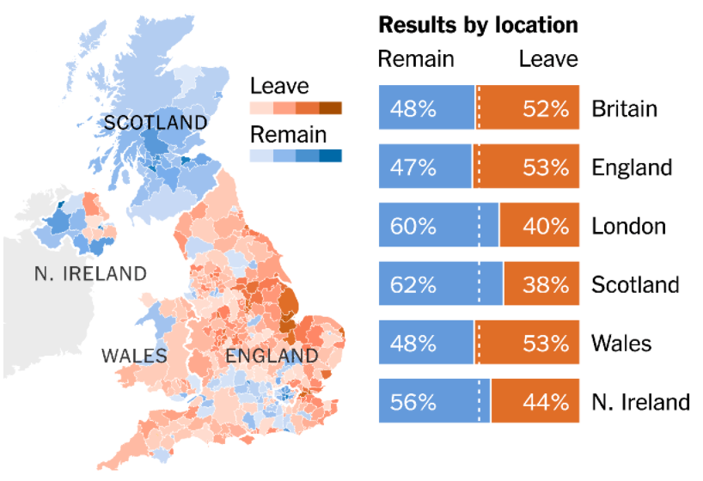
Source: NYT
Notes:
Mueller, “What Is Brexit? And What Happens Next?” New York Times, Jan 31, 2020
https://www.nytimes.com/interactive/2019/world/europe/what-is-brexit.html

Slide 28
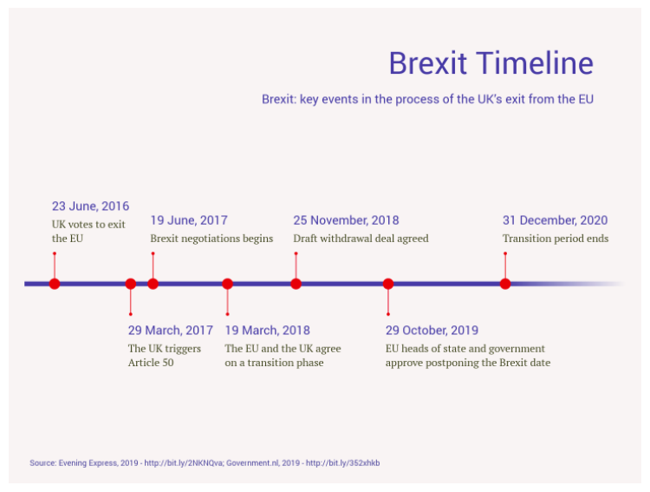

Notes:
Vizzlo
https://vizzlo.com/gallery/timeline/example/brexit-timeline

Slide 29
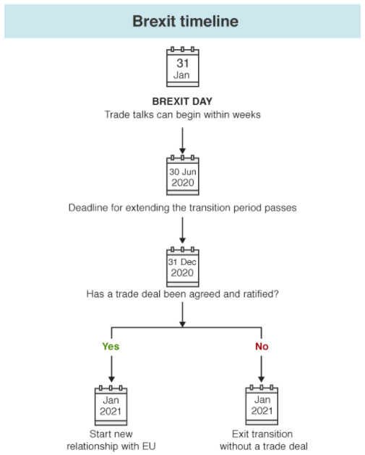

Notes:
BBC, Barnes, Peter, “Brexit: What Happens Now?” Feb 5, 2020
https://www.bbc.com/news/uk-politics-46393399

Slide 30
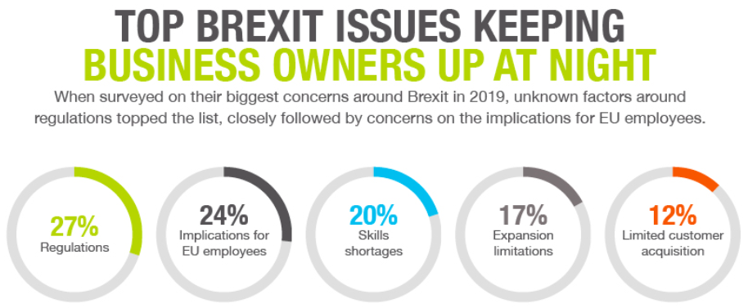

Notes:
InstantOffices
https://www.instantoffices.com/blog/featured/smes-no-strategic-plan-brexit-survey-results/

Slide 31
Brexit Issues
Five Biggest
  Trade
  Migration
  Divorce bill
  Rights of Citizens
  Border with Ireland

Slide 32
Brexit Issues
And many others
  Fisheries
  Agriculture
  Airlines
  Digital services tax
  Financial regulation
  Bank “passports”
  Employment right
  Refugees

Slide 33

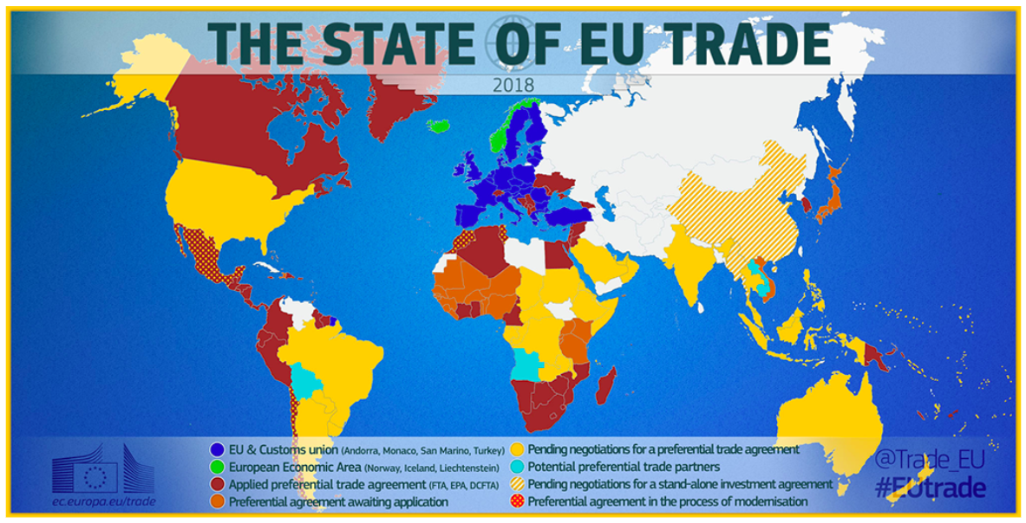
EU has trade agreements with many countries. UK loses these with Brexit.
Notes:
EU
https://www.consilium.europa.eu/en/infographics/eu-trade-map/

Slide 34
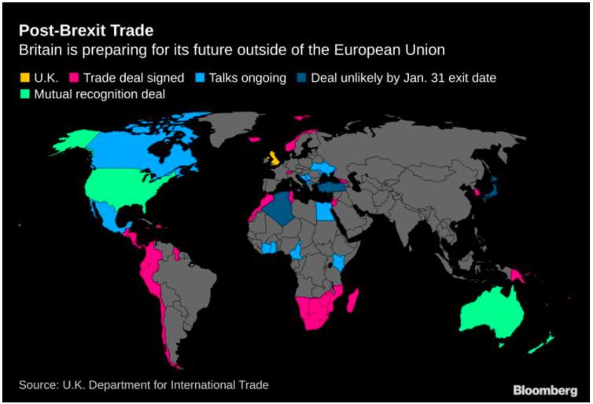
UK is now negotiating many agreements to replace the EU agreements.
Notes:
Bloomberg
https://www.bloomberg.com/news/articles/2020-01-15/u-k-is-trying-to-roll-over-trade-deals-eu-has-with-others-map

Slide 35
Pandemic
Too much specialization with free trade?
Unsure about policy response
Adds to distrust of trade

Slide 36
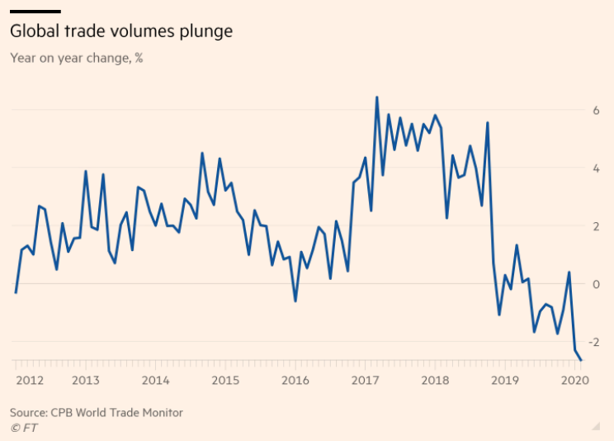
Notes:
Romei, Valentina, FT, Apr 24, 2020
https://www.ft.com/content/db3427f5-5394-4661-8e52-6447fd3d9ae9

Slide 37
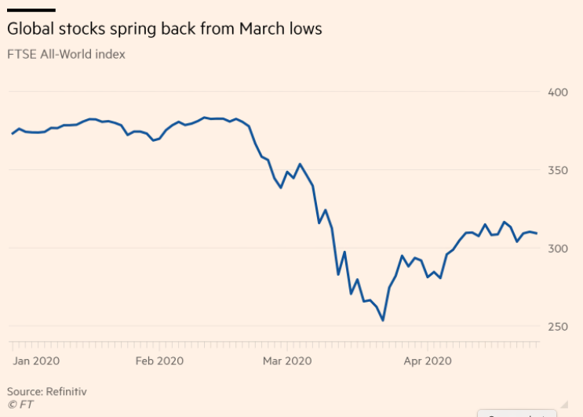
Notes:
Wigglesworth, Robin, FT Apr 24, 2020
https://www.ft.com/content/10d24f35-dee9-4991-a7bd-51be9097a100

Slide 38
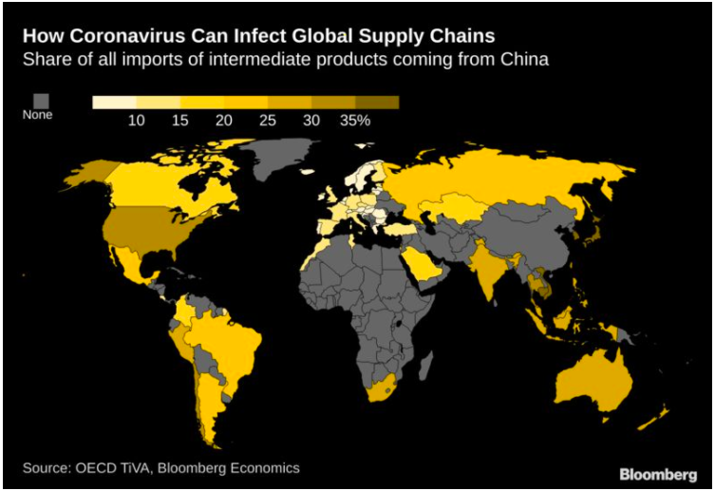
Source: Bloomberg, Jan 31, 2020
Notes:
Cousin, Maeva, “How the Coronavirus Can Infect Global Supply Chains,” Bloomberg, Jan 31, 2020
https://www.bloomberg.com/news/articles/2020-01-31/how-the-coronavirus-can-infect-global-supply-chains-map

Slide 39
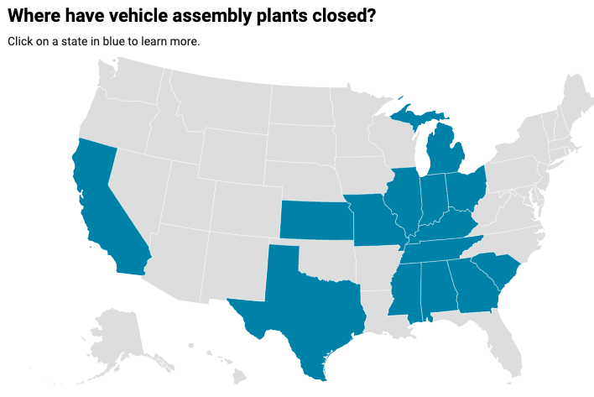
Plans to restart
As of Apr 22:
Ford: None
GM: None
FCA: sometime after May 3
Others: See map
5/4
5/11
5/4
5/4
5/4
5/3
4/27
5/11
5/4
4/27
5/4
4/13
5/4
Source: Automotive News, March 25, 2020
Notes:
Automotive News, March 25, 2020
https://www.autonews.com/manufacturing/follow-latest-assembly-plant-closings

Slide 40
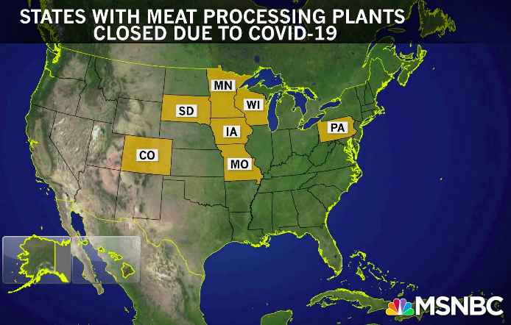
Source: MSNBC Apr 20
Notes:
Rachel Madow Show, MSNBC, Apr 20, 2020
https://www.msnbc.com/rachel-maddow/watch/meat-processing-plants-prove-particularly-vulnerable-to-coronavirus-82318405836

Slide 41
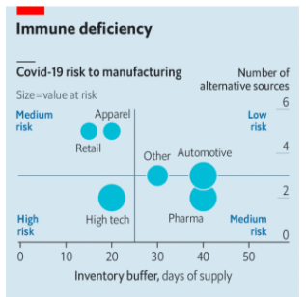
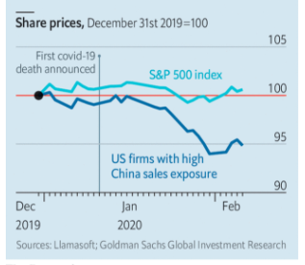
The new coronavirus could have a lasting impact on global supply chains
Source: Economist, Feb 15, 2020
Notes:
Economist Feb 15, 2020
https://www.economist.com/international/2020/02/15/the-new-coronavirus-could-have-a-lasting-impact-on-global-supply-chains

Slide 42
Future of World Trading System
Multilateral agreements already lost
WTO dispute settlement broken
Loss of US as global leader

Slide 43
Any Questions?
Alan V. Deardorff
Ford School of Public Policy
University of Michigan
alandear@umich.edu

